Slide 1
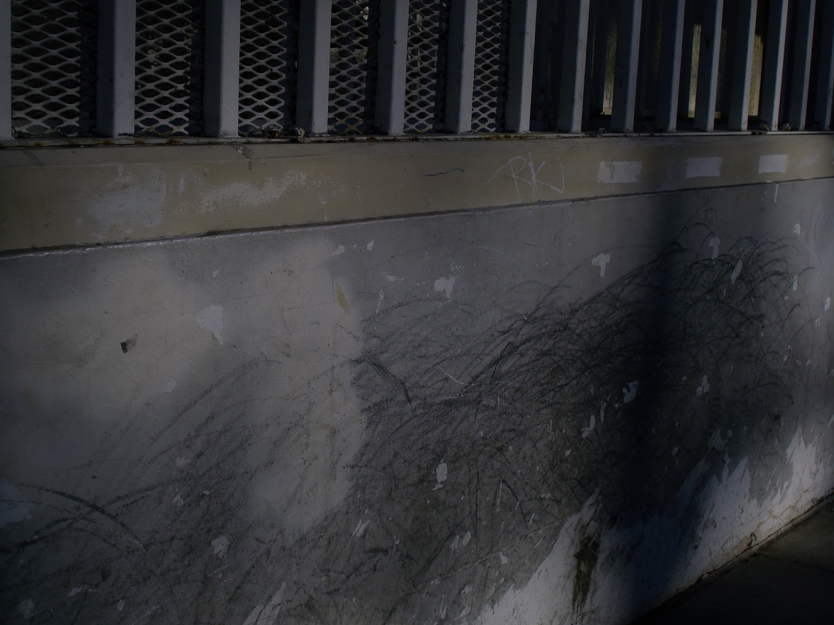

UNDERBRIDGE design

Slide 2
UNDERBRIDGE design

Slide 3
UNDERBRIDGE design

Slide 4


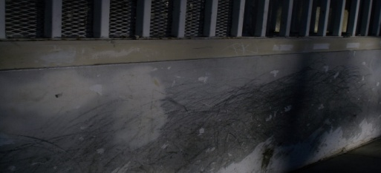



UNDERBRIDGE DESIGN LOGO SHEET (LOGO, BUSINESS CARD, LETTER HEAD, FAX HEAD, ENVELOPE)
UNDERBRIDGE design
Font: cordia new
text : RGB W 242, 242,242 BLK 3,3,3
RGB 236,241,31
RGB 194, 194, 194
RGB 12,12,12
UNDERBRIDGE design
UB design
0NE ELM STREET
VENICE CA 90210
S
underbridgedesign.com 310.666.6666
UNDERBRIDGE design
ONE ELM STREET VENICE CA 90210
underbridgedesign.com 310.666.6666
ONE ELM STREET VENICE CA 90210
underbridgedesign.com PH 310.666.6666 PH 310.666.6666
UNDERBRIDGE design

Slide 5
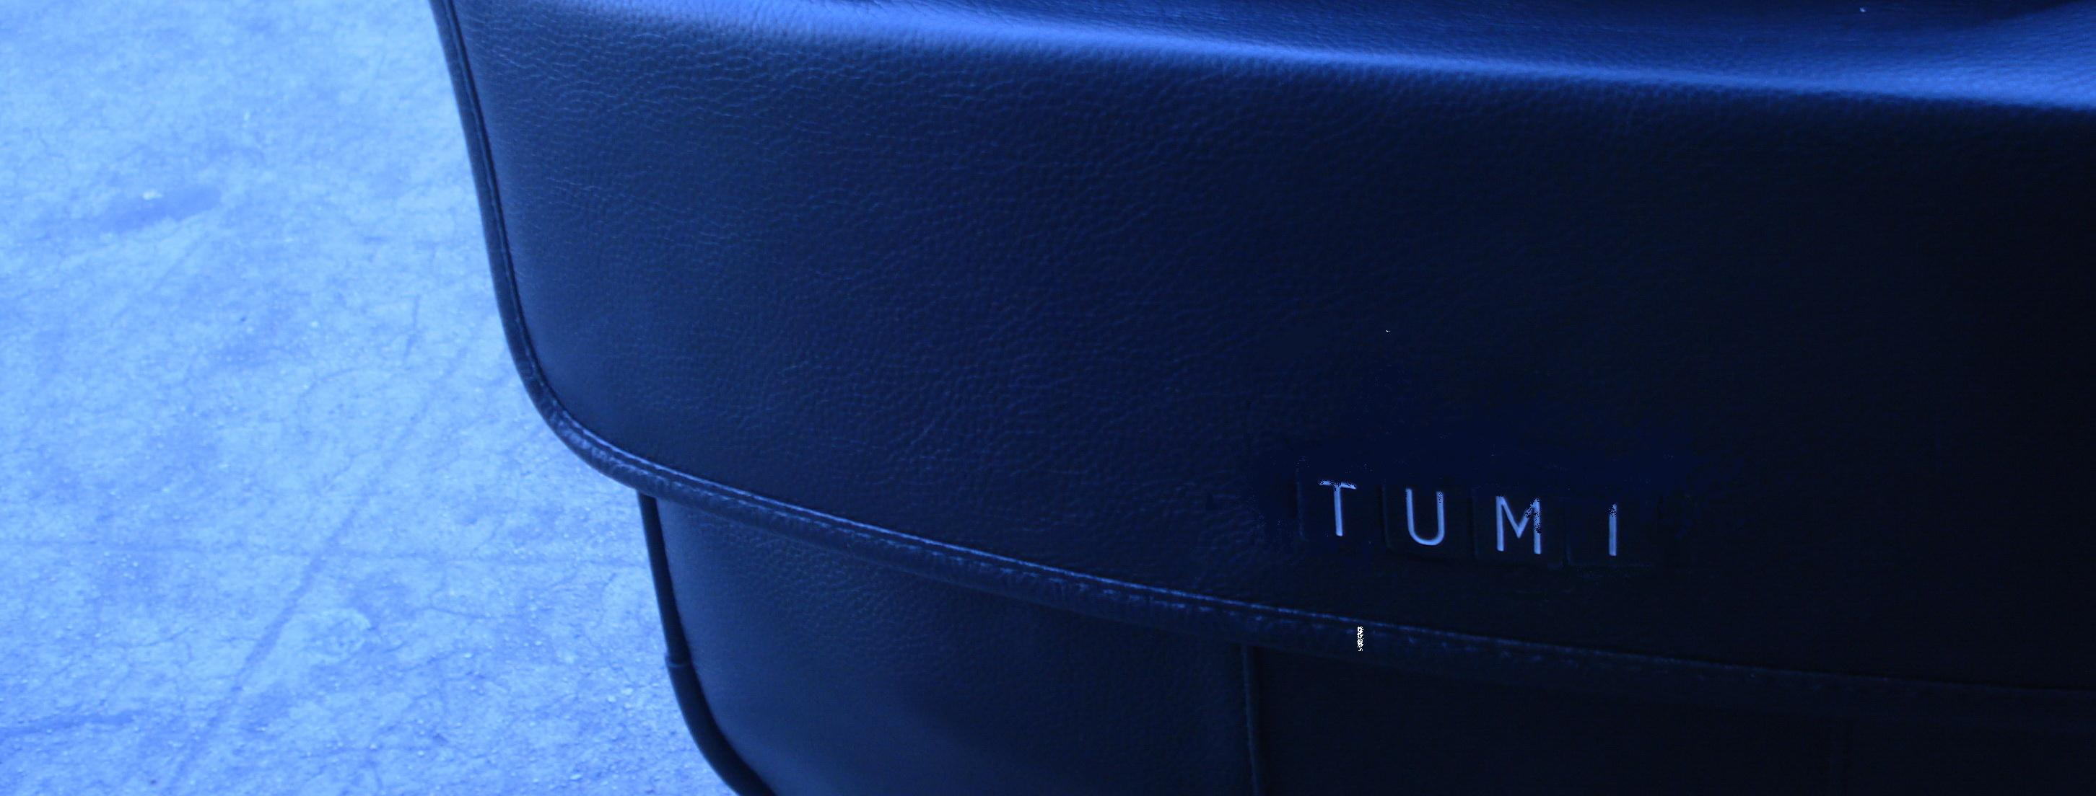


Leather Laptop 250

Slide 6
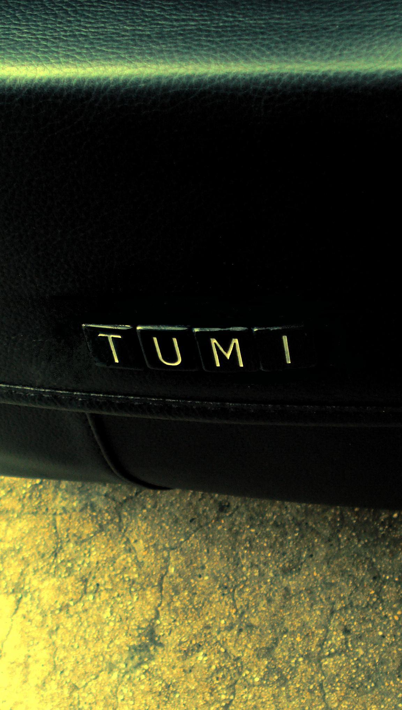

Leather shaving kit 100

Slide 7
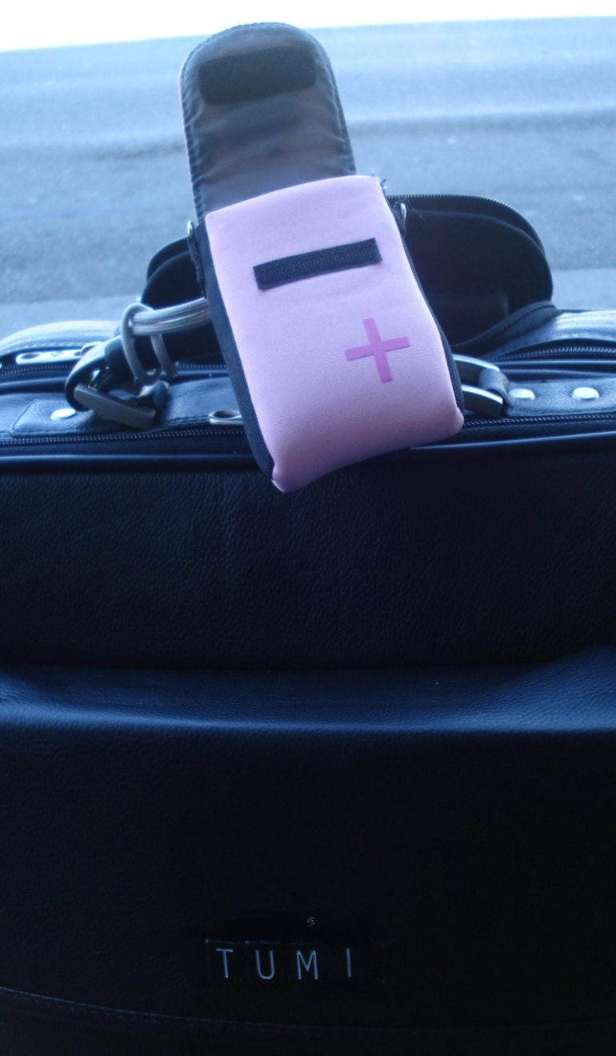
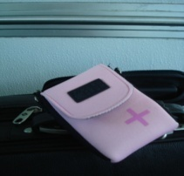

Camera pouch 60

Slide 8

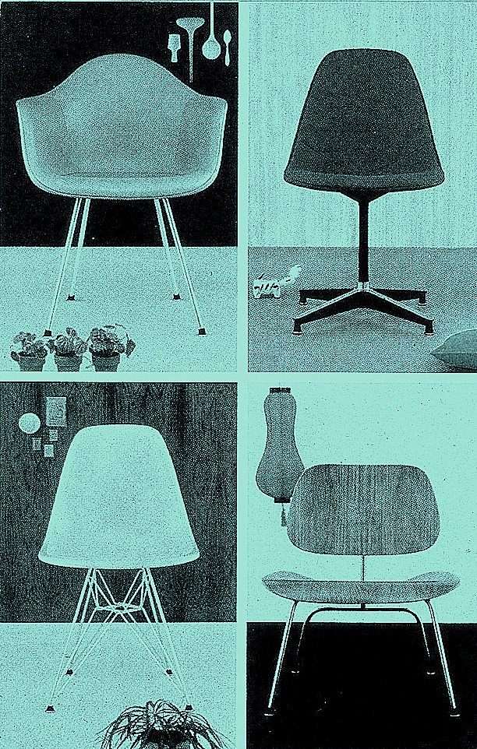
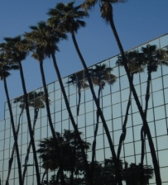
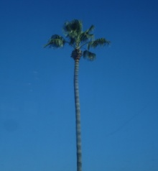

Slide 9





2008
MERCEDES-BENZ
2008 FINANCING
2007
MERCEDES-BENZ
2007 FINANCING
CALABASAS
AUTO
SERVICE
DESK
SCHEDULE A TEST DRIVE
CONTACT
A CERTIFIED REPRESENTATIVE
OUR COMMITMENT IN 2008
WELCOME TO MERCEDES-BENZ OF CALABASAS,
THE PREMIER MERCEDES-BENZ IN SOUTHERN CALIFORNIA.

Slide 10

Jesus christ
Super Summer 2008

Slide 11
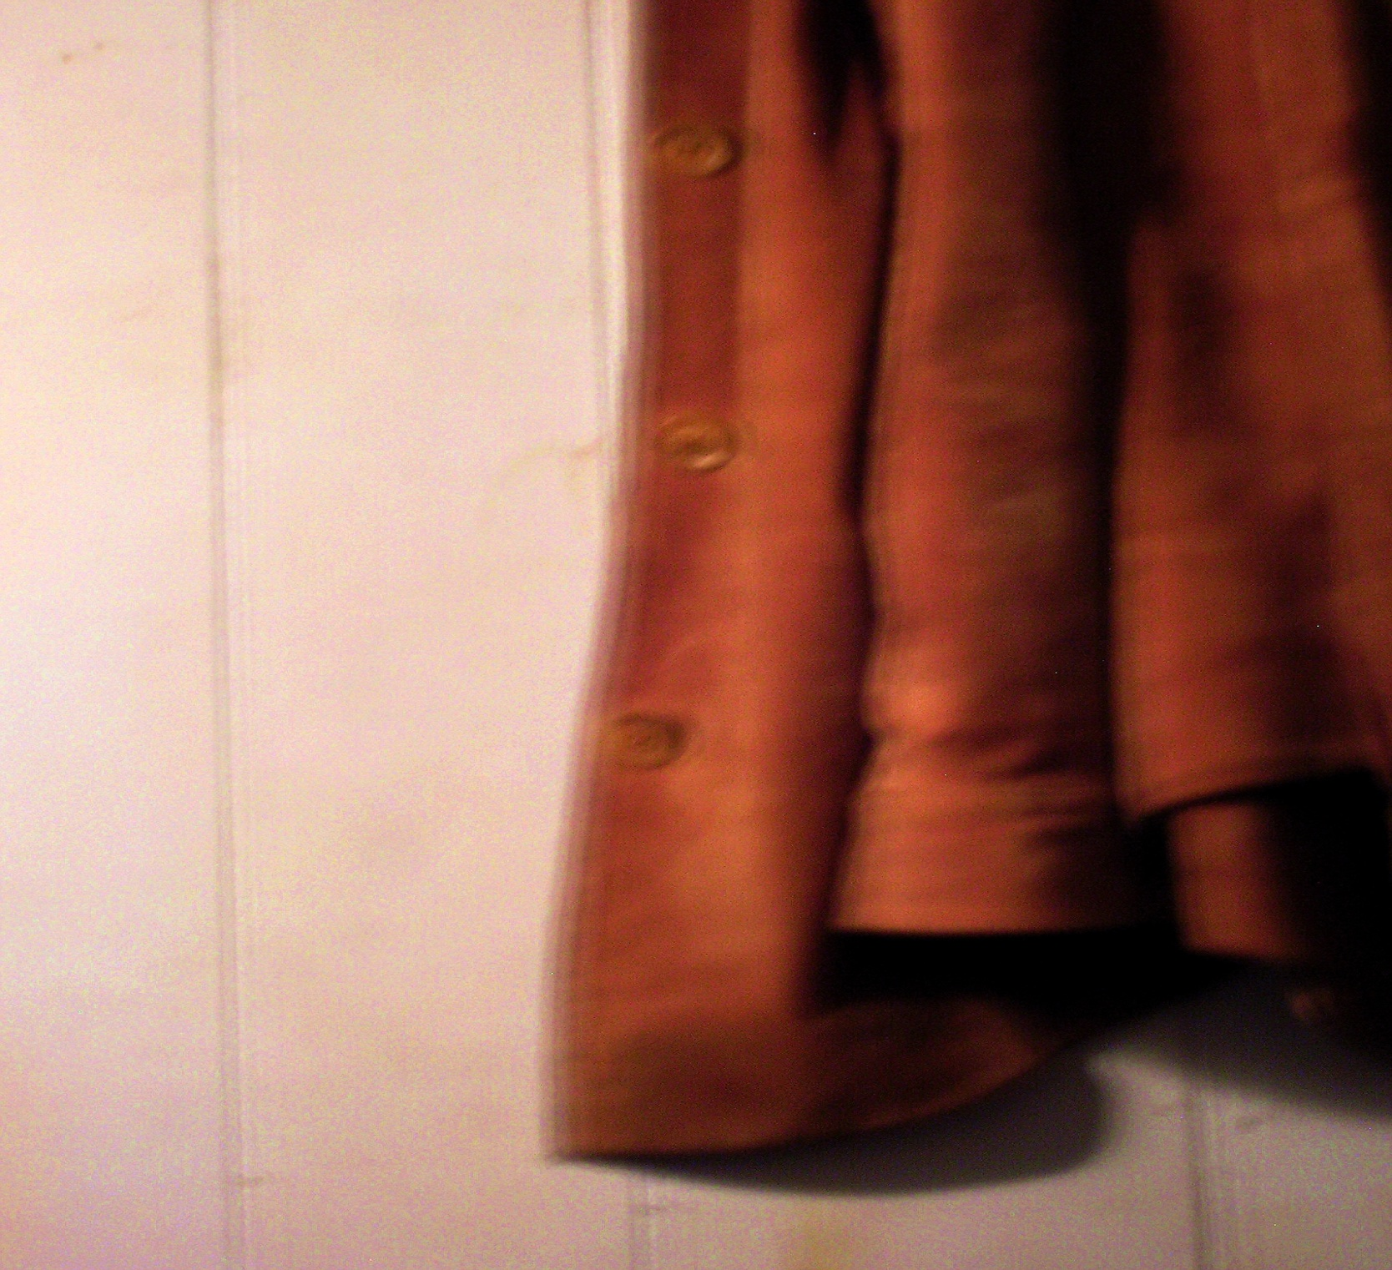

SUEDE
BANANA REPUBLIC

Slide 12
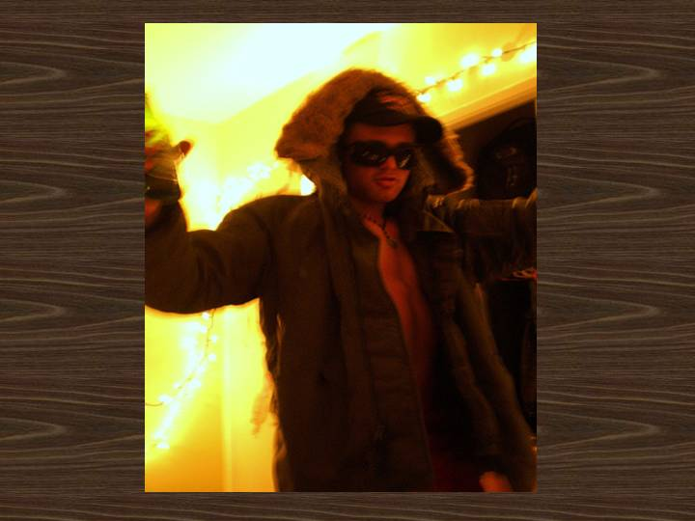



VoLcom

Slide 13

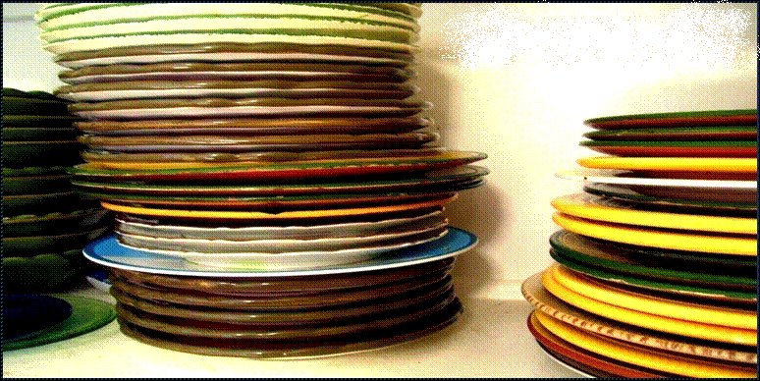
Dishes for your lazy summer afternoons in five summer colors. These bright, and cheerful Italian Ceramic plates, saucers and mugs wont fade over time and are dishwasher safe. The light weight and thick bodies make them extremely durable ..for you to enjoy for years to come. Mix or match colors to add a unique flare to your BBQ. Only available this summer… and only available at your summer party headquarters…
POTTERYBARN.COM

Slide 14
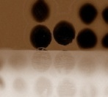
1414 south johns blvd. south Philly
792.656.8746
Sushi
meeshi
Order Delivery NOW
Our menu

Slide 15

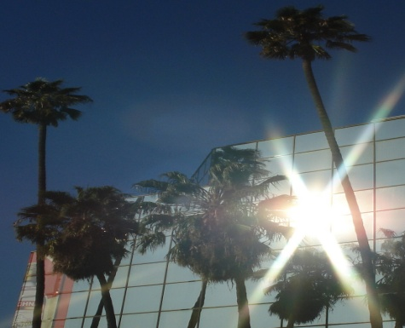
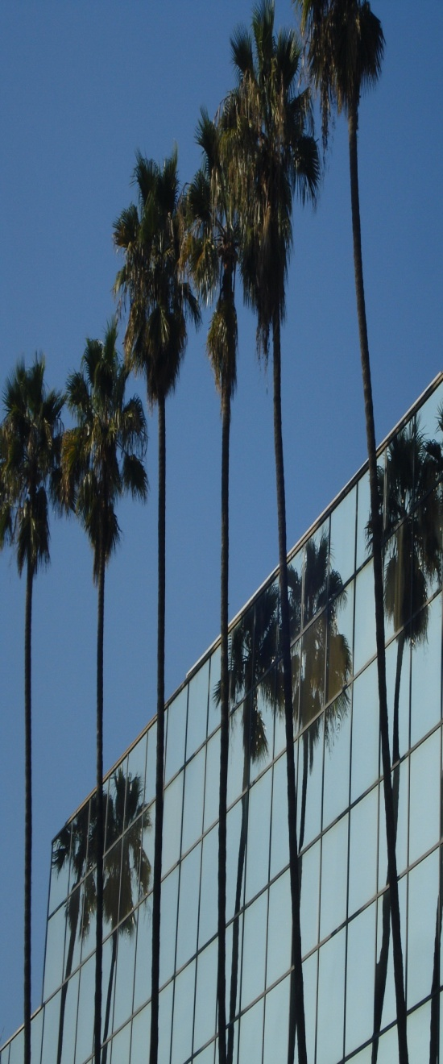
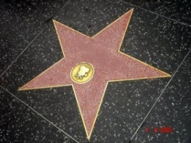

HOLLYWOOD
CALIFORNIA

Slide 16
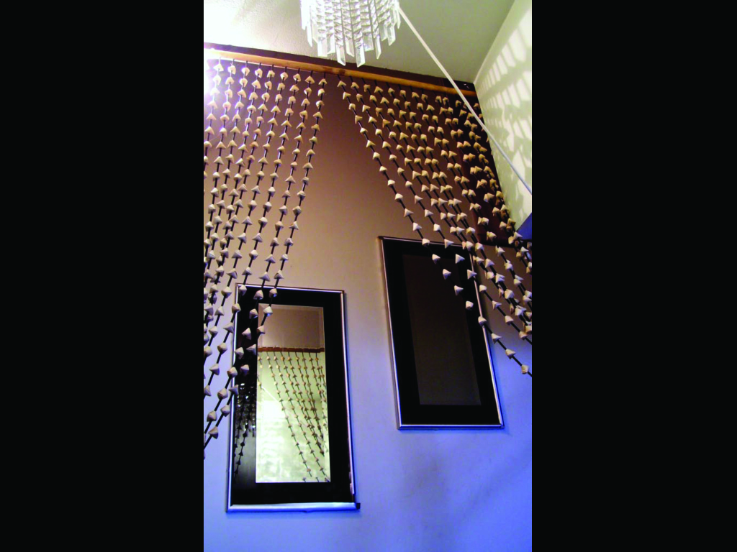
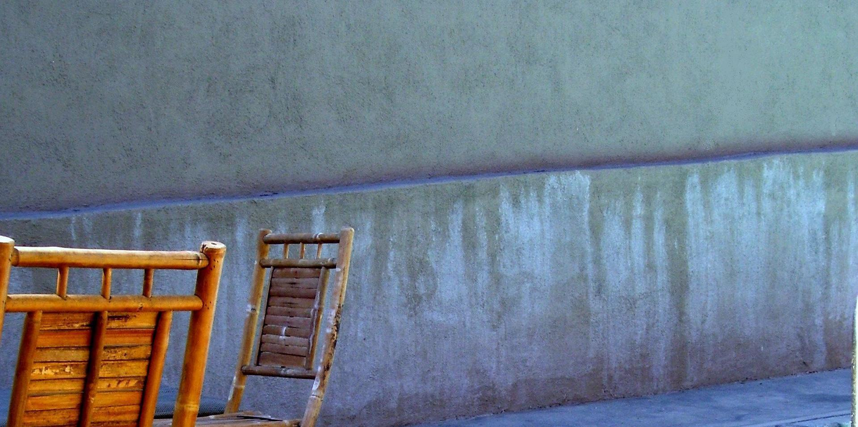
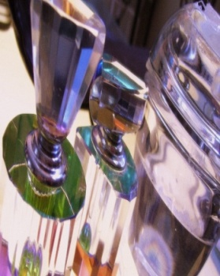
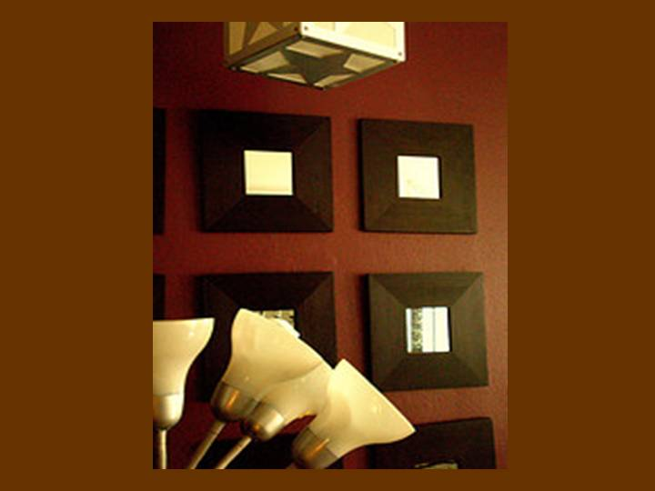
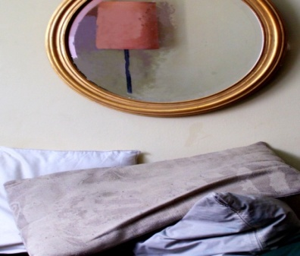
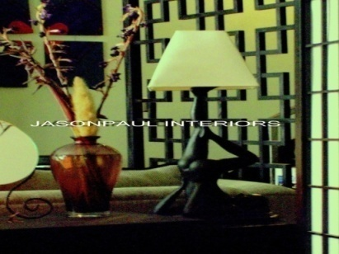
JASON ADLER DESIGN

Slide 17


Slide 18
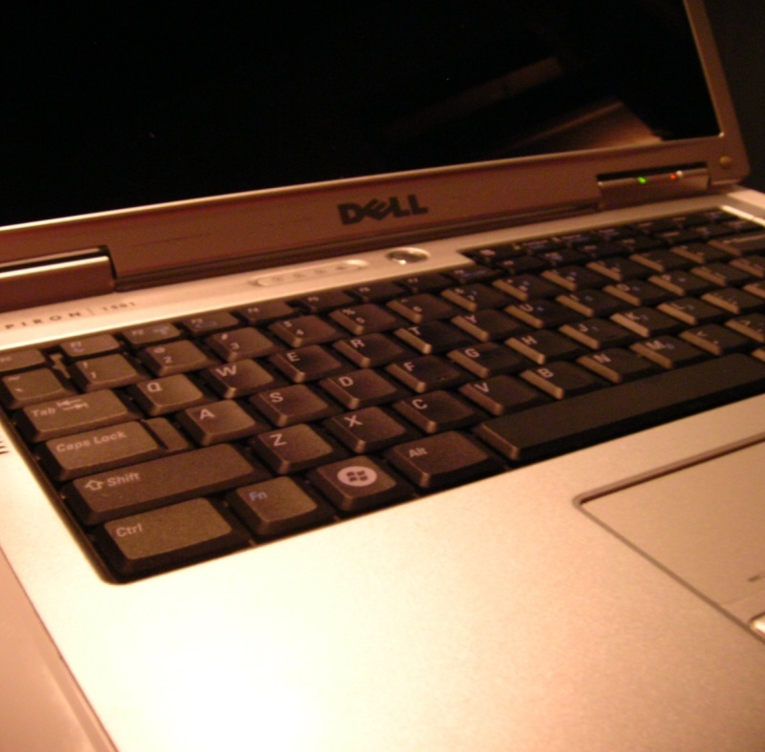
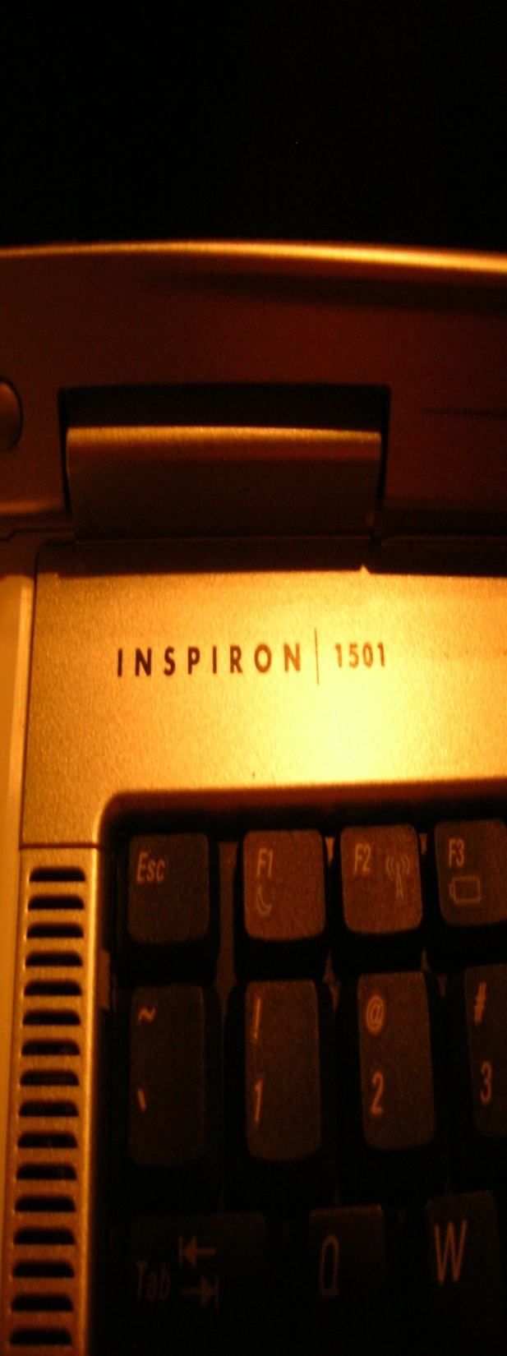

don sherman
teknician
MIS/Networking /VIRUS PRO
Home or Office. Windows XP, Vista or Mac friendly.
12564 Ventura Blvd Sherman Oaks, CA 90436 310-987-6754
…Proudly Serving the Valley since 2004

Slide 19
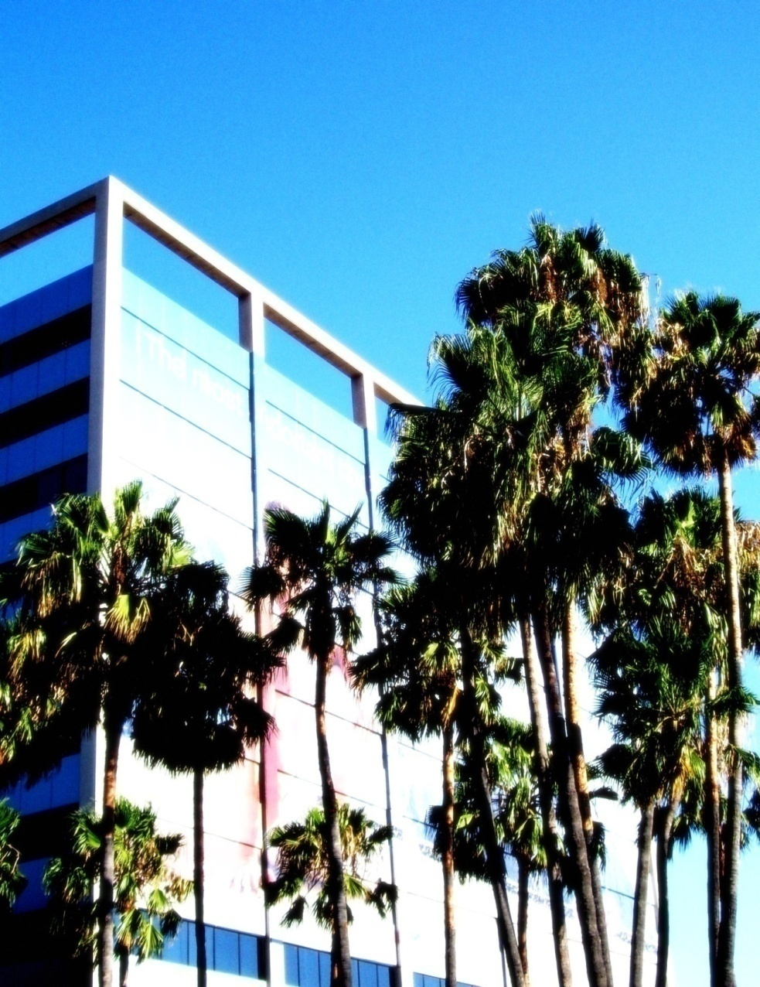

For offical transcript sof all meetings held by the assembly write to:
Transcripts
1498 blankly ave.
Sacramento, CA 98765
STATE OF
california
ASSEMBLY
MEETING NOTES MAY 23, 2007

